Slide 1
Automatic Detection of Religiously Abusive
Text on Social Media using Deep Learning
Techniques
Presented By
Alamgir Hossain
ID: 1604069
Dept. of CSE, CUET
Supervised By
Dr. Mohammed Moshiul Hoque
Professor
Dept. of CSE, CUET

Slide 2
Contents
Introduction
Motivation
Challenges
Task Description
Previous Works
Contributions
Dataset Descriptions
Outline of Methodology
Result Analysis
Performance Comparison
Error Analysis
Conclusion

Slide 3
Introduction
Provocations on occasion, as well as the ease of access to social media, have led to huge dissatisfaction among online religious groups.
Religious abuse is one of the most abundant categories among of abuse.
Identifying and categorizing religious abuse manually is a difficult task.
This kind of task is still in preliminary stage for low resource languages like Bengali.

Slide 4
Motivation
    No system is developed yet to identify and categorize religiously abusive Bengali texts.
    Such system is required to ensure security in the cyberspace
    The spread of toxicity over social media can be reduced.
    Develop resources and models for Bengali.

Slide 5
Challenges
    Lack of linguistic tools
    Scarcity of benchmark corpora
    Overlapping characteristics with correlated phenomena
    Dealing with a large number of different local words.

Slide 6
Task Description
Hierarchical annotation schema to divide the corpus into two levels:
  (A) Religious text identification
  (B) Classification of religious texts
Level A: Religious Text Identification
  Religious texts (RE): religious belief, attack, incite or seek to harm an individual, group or community based on some criteria such as religious ideology.
  Non religious texts (NoRE): do not contain any statement of religion or express hidden wish/intent to harm other religion.

Slide 7
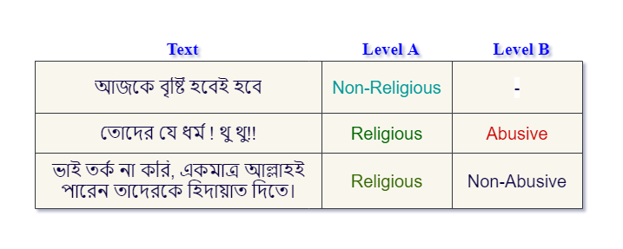
Task Description(Cont.)
Level B: Classification of Religious Text
  Religious Abusive (ReAb): incite violence by attacking religion (Islam, Hindu, Catholic, etc.), religious organizations, or religious belief of a person or a community.
  Religious Non Abusive (ReNoAb): normal religious ideology, belief, mannerly quote or peaceful statement that doesn’t provoke religious belief of individuals or a community.

Slide 8
Previous Work
1. Abusive content detection in transliterated Bengali-English social media corpus[1] (Sazzed, 2021)
Can detect abusive or not from any transliterated Bangla text.
Used Support Vector Machine (SVM).
Limitations:
Deals with YouTube comments only.
Detect only two classes.
2. Multi-label hate speech and abusive language detection in Indonesian Twitter[2] (Ibrohim et al., 2021)
Multi-label text classification for abusive language and hate speech
Used Random Forest Decision Tree (RFDT).
Limitations:
Worked only on Indonesian Tweets.

Slide 9
Previous Work(Cont.)
3. An abusive text detection system based on enhanced abusive and non-abusive word lists[4] (Lee et al., 2018)
Enhanced abusive and non-abusive word lists.
Used unsupervised learning of abusive words.
Limitations:
Used a word list that can be used for multiple meanings in the real world.
Detect only two classes.
4. Identify Abusive and Offensive Language in Indonesian Twitter using Deep Learning Approach[5] (Ibrohim et al., 2019)
Implemented deep learning approach to identify abusive language.
LSTM with FastText performed better.
Limitations:
Worked only on Indonesia Tweets.
Identify only two categories.

Slide 10
Contributions
    Developed a Religious Text Corpus containing Bengali texts. Hierarchical annotation schema uses to classify Religious texts into abusive and non-abusive classes.
    Prepared a model to identify religiously abusive texts by investigating several deep learning models.
    Evaluated model performances to find the appropriate model for Bengali Religious Texts.

Slide 11
Dataset Description
Level | Class | Train | Test
Identification | Religious | 2180 | 727
 | Non-religious | 826 | 275
Classification | Religious Abusive | 1573 | 530
 | Religious Non-abusive | 607 | 197
Table 1 : Level-wise number of sample texts in each category

Slide 12
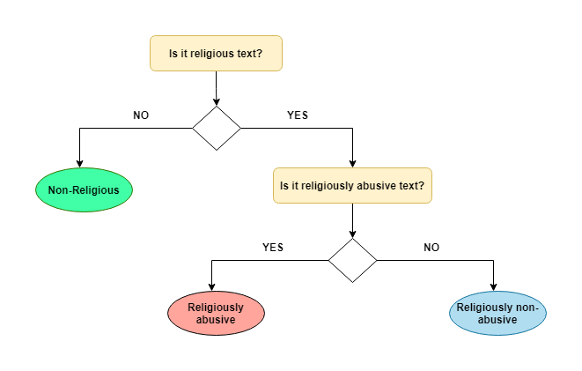
Annotation Schema
Figure 1 : Annotation Schema the corpus

Slide 13
Annotation Schema(Cont.)
    The labels of each category was defined manually by two annotators and then checked by a NLP expert.
    Standard rules for annotation was followed.
    The Cohen’s Kappa score is calculated to determine the percentage of similarity in annotation.
    We find almost a perfect agreement on annotating the corpus.

Slide 14
Annotation Schema(Cont.)
 | Cohen’s Kappa Value
 | Identification Level | Classification Level
Pair-1 | 0.97877 | 0.93502
Pair-2 | 0.94526 | 0.91524
Pair-3 | 0.93215 | 0.97112
Table 2 : Pair-wise Cohen’s Kappa values

Slide 15
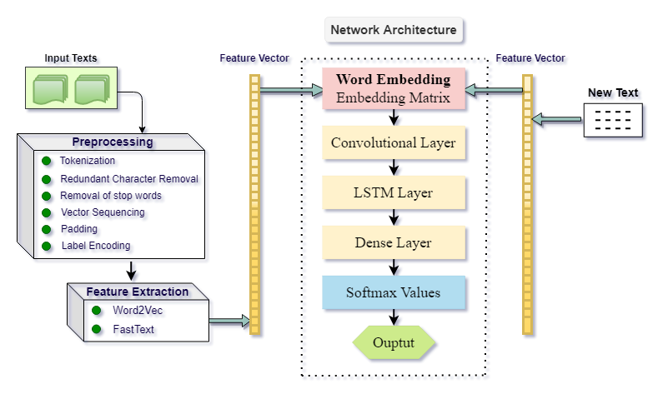
Outline of Methodology
Figure 2 : Outline of the system

Slide 16
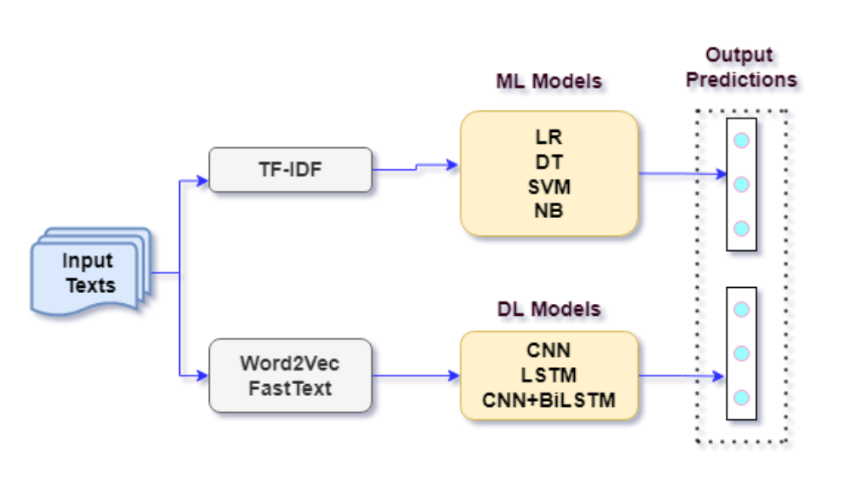
Abstract Methodology
Figure 3 : Abstract Method of Religiously Abusive Comment Detection

Slide 17
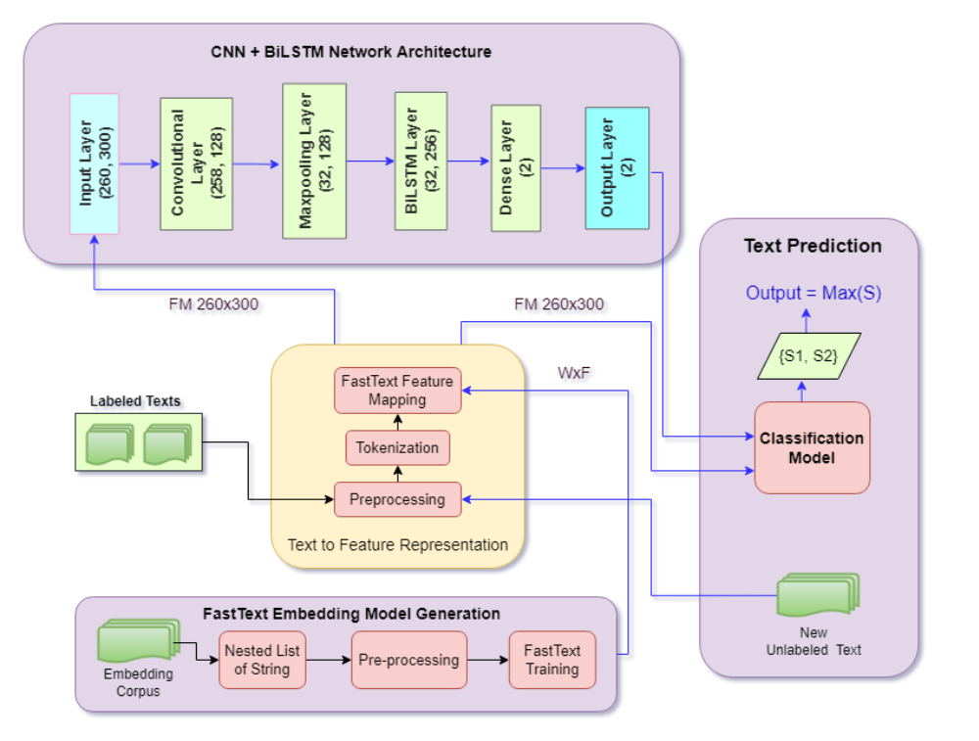
Framework of the System
Figure 4: Framework of the System Using Deep Learning based Model

Slide 18
Outline of Methodology(Cont.)
Feature Extraction
  Cleaned the dataset before extracting features.
  Extracted the textual features both for DL baselines.
  The feature vector is used to find values for both train and test
  Used pretrained FastText vectorization and embedded it through embedding layer for training DL models
  Used embedding vector of the dimension of 100.
  Used a pre-trained embedding matrix.

Slide 19
Outline of Methodology (Cont.)
Hyperparameters | Values
Filter Size | 0.2
Pooling Type | ‘max’
Neurons in dense layer | 2
Number of units | 128
Batch size | 32
Hyperparameters | Values
Dropout rate | 0.2
Optimizer | ‘adam’
Learning Rate | 1e⁻⁵
Epoch | 25
Batch size | 32
Table 3 : List of hyperparameters values

Slide 20


Result Analysis
Identification Level
 | Precision | Recall | F1 score | Accuracy | AUC Area
CNN | 0.79 | 0.59 | 0.60 | 0.59 | 0.6938
LSTM | 0.73 | 0.63 | 0.65 | 0.63 | 0.6641
BiLSTM | 0.80 | 0.76 | 0.77 | 0.76 | 0.7653
CNN+BiLSTM | 0.87 | 0.86 | 0.86 | 0.86 | 0.8413
CNN | 0.74 | 0.67 | 0.68 | 0.67 | 0.6776
LSTM | 0.85 | 0.80 | 0.81 | 0.80 | 0.8295
BiLSTM | 0.84 | 0.80 | 0.81 | 0.80 | 0.8222
CNN+BiLSTM | 0.91 | 0.90 | 0.90 | 0.90 | 0.8424
Table 4 : Comparison of Performance among the used models

Slide 21
Result Analysis(Cont.)
Identification Level
  Without embedding the feature vector the CNN + BiLSTM model gained the rich scores regarding of the performance parameters.
  After embedding the feature vector obtained from a pre-trained vectorizer model the performance of the combined CNN + BiLSTM model is increased more.
  The CNN + BiLSTM(FastText) performed best among all 8 classifiers.

Slide 22
Result Analysis(Cont.)
Classification Level
 | Precision | Recall | F1 score | Accuracy | AUC Area
CNN | 0.76 | 0.68 | 0.70 | 0.68 | 0.7071
LSTM | 0.73 | 0.57 | 0.59 | 0.57 | 0.6419
BiLSTM | 0.81 | 0.78 | 0.79 | 0.78 | 0.7712
CNN+BiLSTM | 0.83 | 0.82 | 0.82 | 0.82 | 0.7903
CNN | 0.72 | 0.70 | 0.70 | 0.70 | 0.6457
LSTM | 0.89 | 0.89 | 0.89 | 0.89 | 0.8658
BiLSTM | 0.90 | 0.89 | 0.89 | 0.89 | 0.8699
CNN+BiLSTM | 0.92 | 0.90 | 0.91 | 0.90 | 0.8724
Table 5 : Comparison of Performance among the used models

Slide 23
Result Analysis(Cont.)
Classification Level
  Without embedding the feature vector the CNN + BiLSTM model gained the rich scores regarding of the performance parameters.
  After embedding the feature vector obtained from a pre-trained vectorizer model the performance of the combined CNN + BiLSTM model is increased more.
  The CNN + BiLSTM(FastText) performed best among all 8 classifiers.

Slide 24
Performance Comparison
Identification Level
 | CNN | LSTM | BiLSTM | CNN+ BiLSTM | CNN | LSTM | BiLSTM | CNN+ BiLSTM
Religious | 0.62 | 0.69 | 0.82 | 0.90 | 0.74 | 0.85 | 0.86 | 0.93
Non- Religious | 0.55 | 0.52 | 0.64 | 0.76 | 0.54 | 0.71 | 0.73 | 0.73
 | Without FastText | With FastText
Table 6 : Class wise performance measure in terms of f1_score

Slide 25
Performance Comparison(Cont.)
Classification Level
 | CNN | LSTM | BiLSTM | CNN+ BiLSTM | CNN | LSTM | BiLSTM | CNN+ BiLSTM
Religious Abusive | 0.75 | 0.62 | 0.87 | 0.87 | 0.79 | 0.87 | 0.88 | 0.93
Religious Non-abusive | 0.56 | 0.50 | 0.69 | 0.67 | 0.49 | 0.78 | 0.78 | 0.80
 | Without FastText | With FastText
Table 7 : Class wise performance measure in terms of f1_score

Slide 26
Error Analysis
  Both in Identification and Classification level the combined CNN and BiLSTM classifier outperformed the other models.
  In Identification level the CNN+BiLSTM (FastText) model gained a highest F1_score of 0.90.
  In Classification level the CNN+BiLSTM (FastText) model gained a highest F1_score of 0.93.

Slide 27
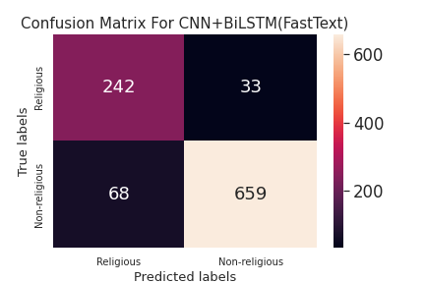
Error Analysis
Identification Level
  The TPR (True Positive Rate) for Religious class is gained by the best model is 88%.
  The TPR for Non-religious class is obtained of 90.64%.
  The number of misclassification of Non-religious category is comparatively high.
Figure 5 : Confusion Matrix for CNN+BiLSTM
(FastText) model

Slide 28
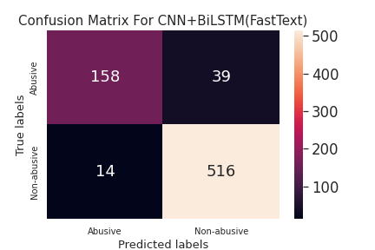
Error Analysis
Classification Level
  The TPR (True Positive Rate) for Religious Abusive class is gained by the best model is 80.2%.
  The TPR for Religious Non-abusive class is obtained of 97%.
  The number of misclassification of Non-abusive category is comparatively high.
Figure 6 : Confusion Matrix for CNN+BiLSTM
(FastText) model

Slide 29
Conclusion
This work aims to build a corpus in Bengali using hierarchical annotation schema.
An automated system is to be built to detect and classify religiously abusive texts in Bengali.
An investigation must be conducted among the models' performances to choose the best model for this task.

Slide 30
References
S. Sazzed: Abusive content detection in transliterated Bengali-English social media corpus. Online: Association for Computational Linguistics, Jun. 2021, pp. 125–130.
M. O. Ibrohim and I. Budi: Multi-label hate speech and abusive language detection in Indonesian Twitter. Italy: Association for Computational Linguistics, Aug. 2019, pp. 46-57.
O. Sharif and M. Hoque: Identification and classification of textual ag- gression in social media: Resource creation and evaluation. Apr. 2021, pp. 9–20, isbn: 978-3-030-73695-8.
H.-S. Lee, H.-R. Lee, J.-U. Park and Y.-S. Han: An abusive text detection system based on enhanced abusive and non-abusive word lists. Decision Support Systems, vol. 113, pp. 22–31, 2018, issn: 0167-9236.
M. Ibrohim, E. Sazany and I. Budi: Identify abusive and offensive language in indonesian twitter using deep learning approach. Journal of Physics: Conference Series, vol. 1196, p. 012 041, Mar. 2019.

Slide 31

Q & A

